Slide 1


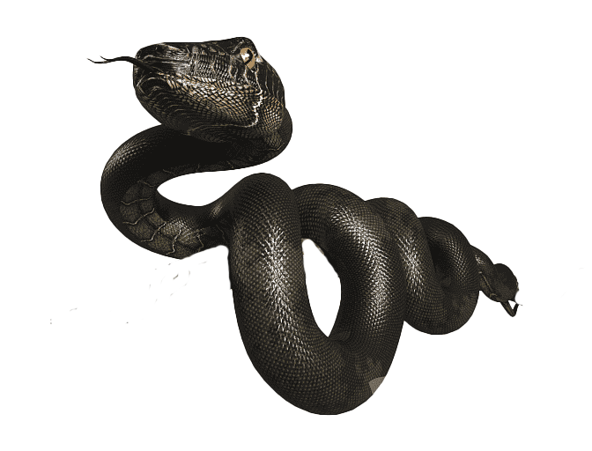
Summer Training Project
Name : Sonu Kumar Chakravarti
Registration no. : 12019857
Project Name : Snake Pygame
Programme : Bachelor of Computer Science & Engineering
1

Slide 2

Snake Pygame Using Python Programming
Python is an interpreted, object-oriented, high-level programming language with dynamic.
Python is a computer programming language often used to build websites and software, automate tasks, and conduct data analysis.
2
Snake Pygame using Python

Slide 3
Snake Pygame
Snake game is one of the most popular arcade games of all time.
In this game, the main objective of the player is to catch the maximum number
of fruits without hitting the wall or itself.
We are use Pygame to create this snake game. Pygame is an open-source library that is designed for making video games. It has inbuilt graphics and sounds libraries.
3
Snake Pygame using Python

Slide 4
Snake Pygame
Steps to create Snake Pygame :
Installing Pygame
Create the Screen
Create the Snake
Moving the snake
Game over when the snake hits the boundaries
Adding the food
Increasing the length a screen
Displaying the Score
4
Snake Pygame using Python

Slide 5
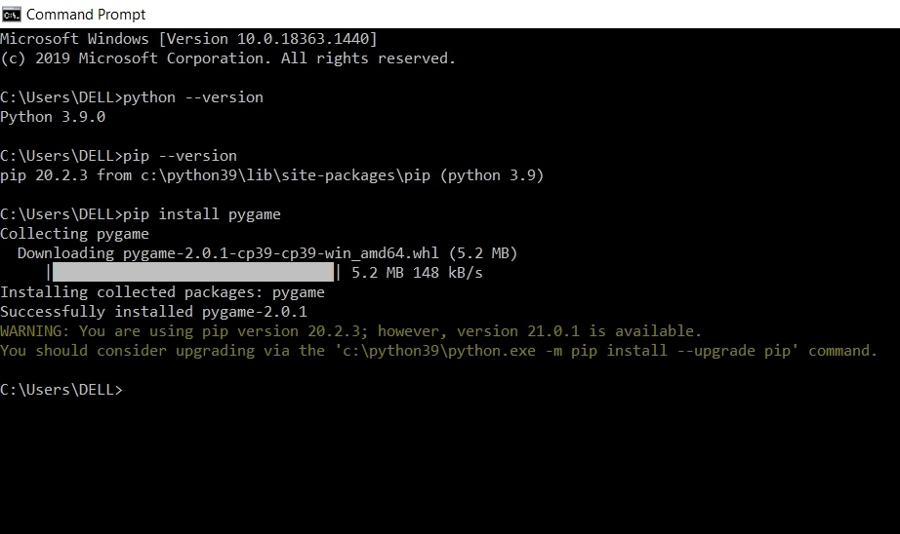
Snake Pygame
Installing Pygame
To install Pygame, open the command prompt and give the command -
[ Pip install pygame ]
5
Snake Pygame using Python

Slide 6
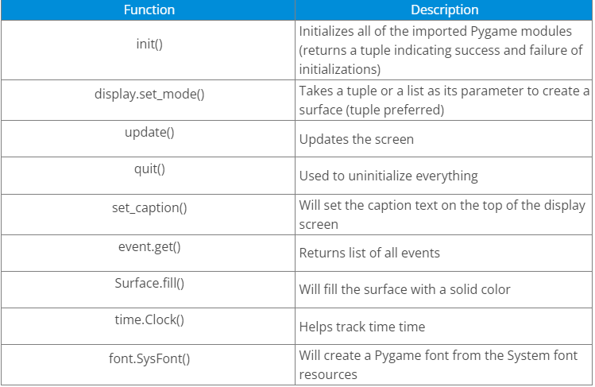
Snake Pygame
Module and functions use in this project
Pygame :
It is a python programming language library for making multimedia applications like games.
6
Snake Pygame using Python

Slide 7
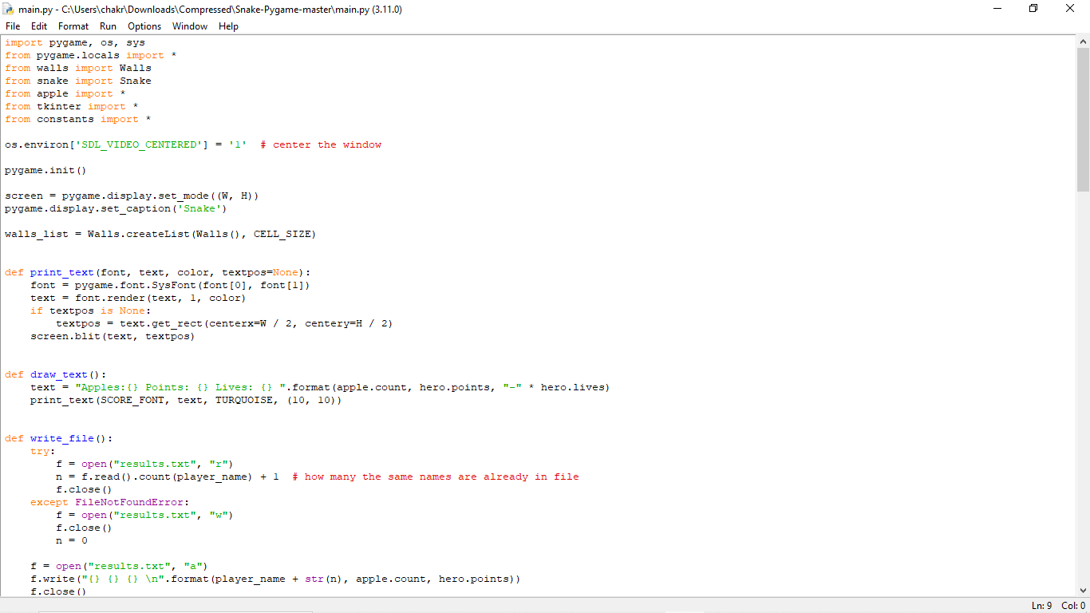
Project Code
7
Snake Pygame using Python

Slide 8
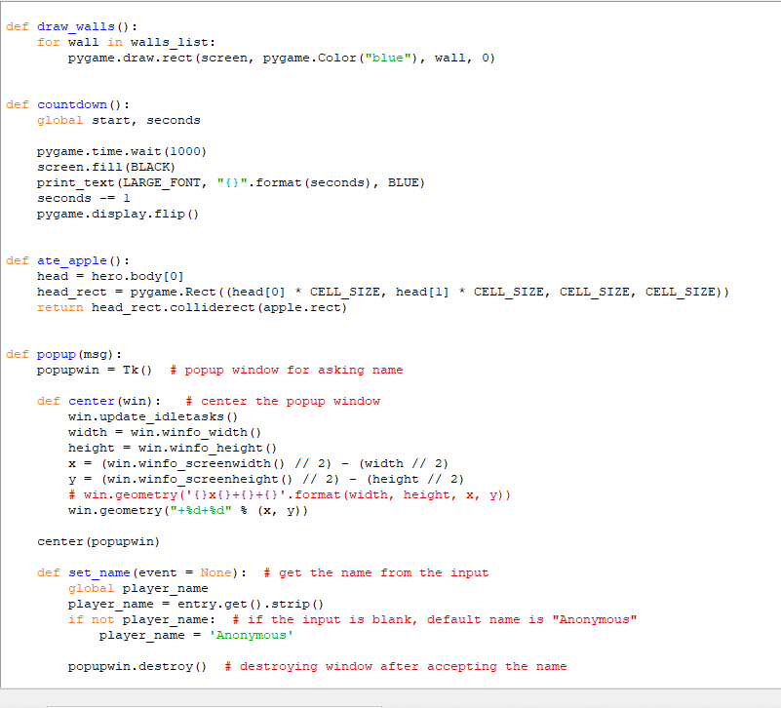
Snake Pygame
8
Snake Pygame using Python

Slide 9
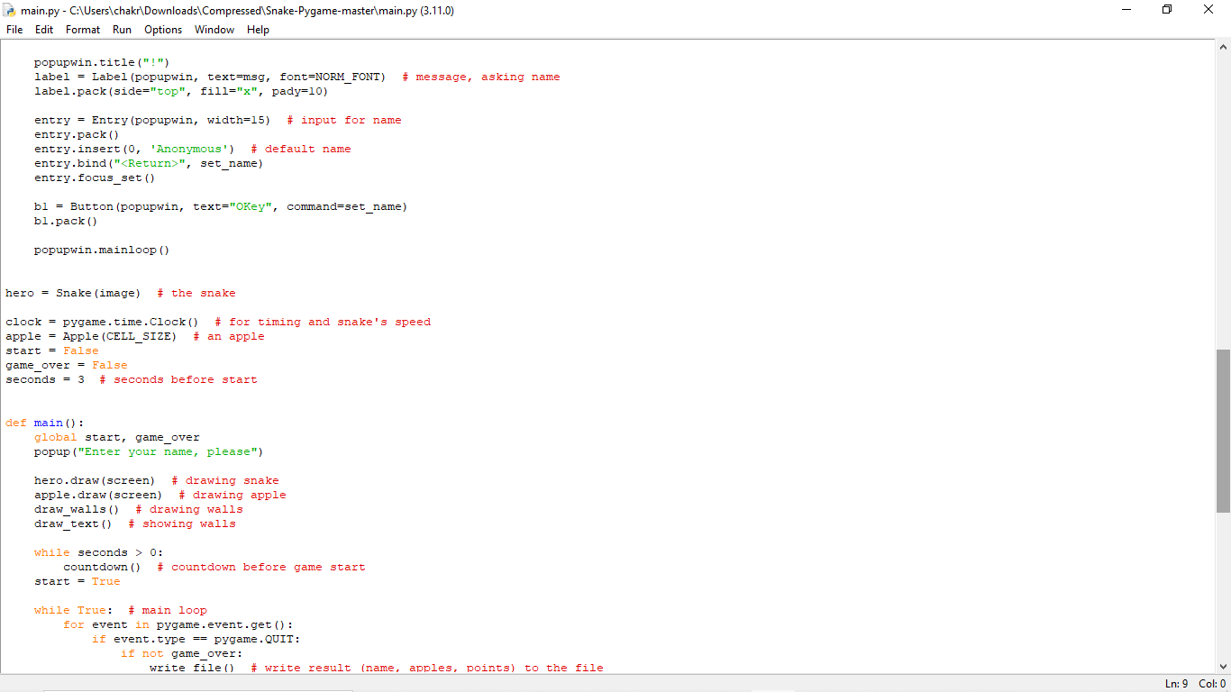
Snake Pygame
9
Snake Pygame using Python

Slide 10
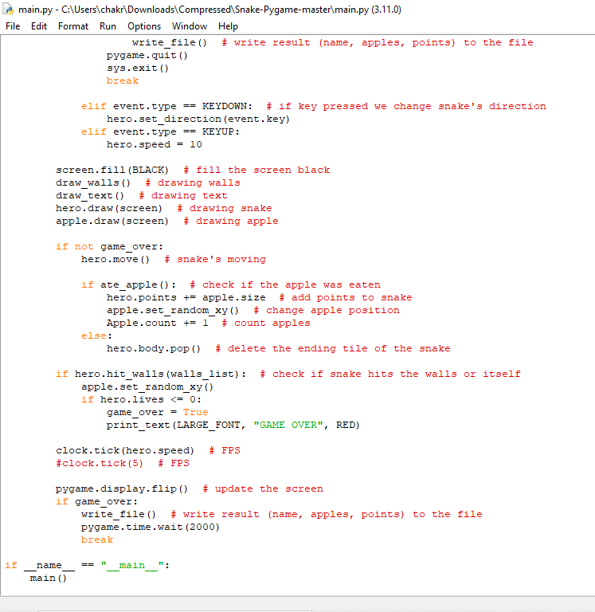
Snake Pygame
10
Snake Pygame using Python

Slide 11
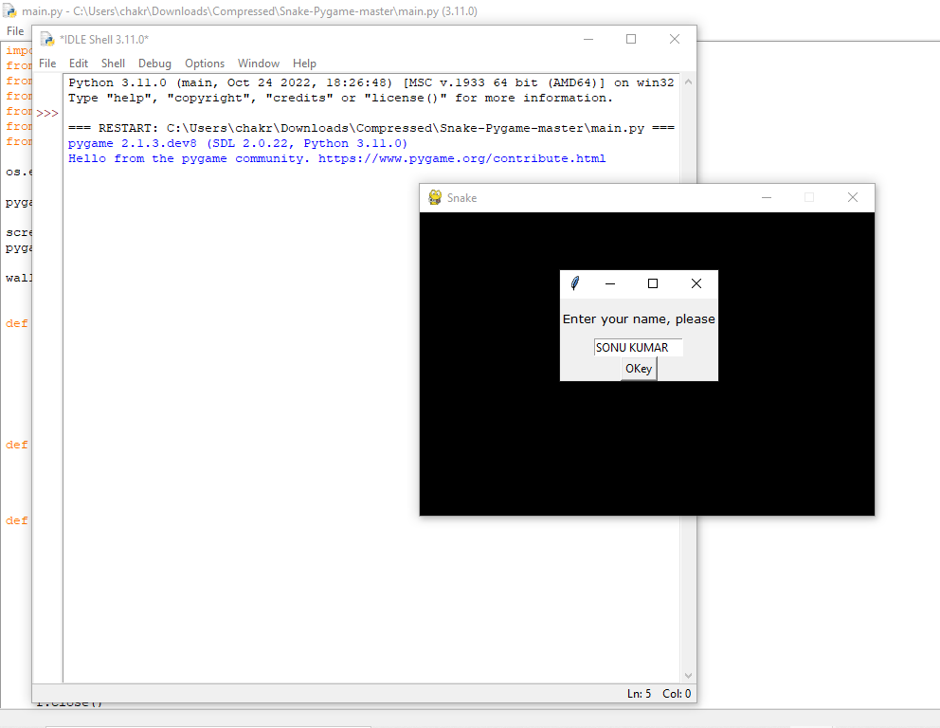
OUTPUT
11
Snake Pygame using Python

Slide 12
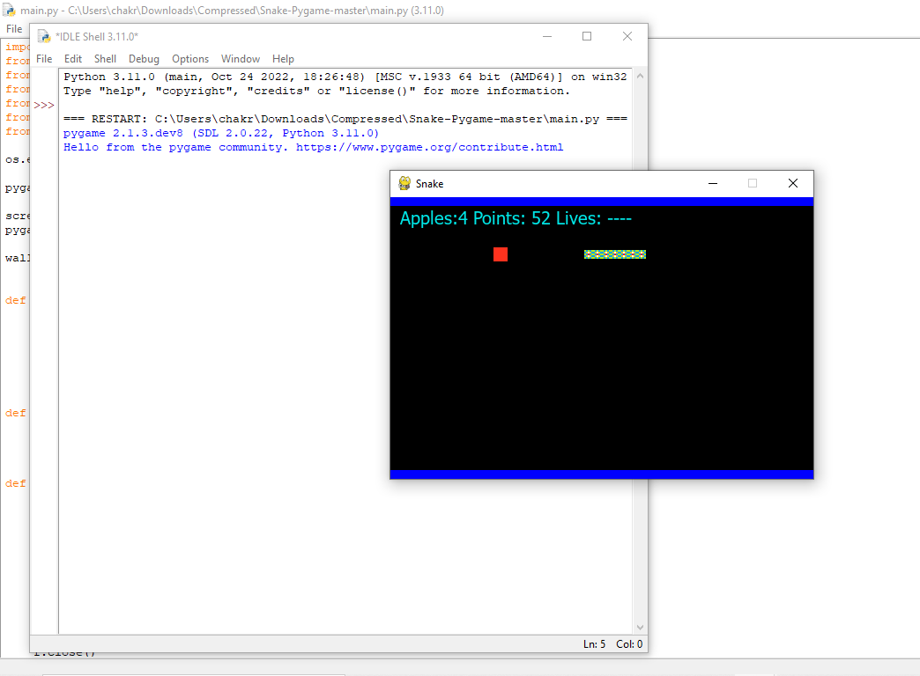
12
Snake Pygame using Python

Slide 13
Conclusion
I have use some module and functions.
Creating a snake game we have have use pygame module here.
After successful creating code we had see the output.
13
Snake Pygame using Python

Slide 14
Thank You
14
Snake Pygame using Python

